Slide 1
Memory Elements Engineering 304
Latches and Flip-Flops
Registers
VHDL versions
Shift Registers and Counters
VHDL versions

Slide 2
Cross-Coupled NOR Latch
Simplest form of memory
Avoid invalid state
(Q-bar=Q)
R
Q
__
Q
S

Slide 3
Gated Latch
Cross-Coupled NAND need S and R inverted
Often SR latches include a control line (Enable)
S
Q
En
Q
R

Slide 4
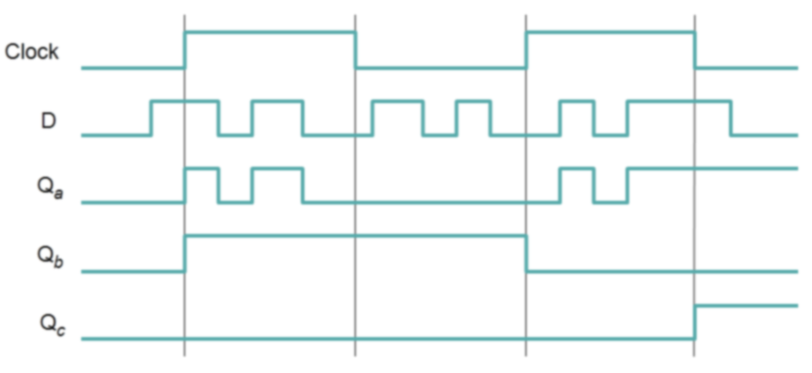
Level vs. Edge
Latches are level-sensitive using Enable input (Q_{a})
book calls the Enable the “CLK”
Flip-flops are edge-triggered using Clock input
Rising (Q_{b}) or Falling (Q_{c})

Slide 5
Level vs. Edge
Latches are level-sensitive using Enable input (Q_{a})
book calls the Enable the “CLK”
Flip-flops are edge-triggered using Clock input
Rising (Q_{b}) or Falling (Q_{c})

Slide 6
Level vs. Edge
Latches are level-sensitive using Enable input (Q_{a})
book calls the Enable the “CLK”
Flip-flops are edge-triggered using Clock input
Rising (Q_{b}) or Falling (Q_{c})

Slide 7
Level vs. Edge
Latches are level-sensitive using Enable input (Q_{a})
book calls the Enable the “CLK”
Flip-flops are edge-triggered using Clock input
Rising (Q_{b}) or Falling (Q_{c})

Slide 8
Characteristic Table
Truth Table that includes time aspect (Q(t) -> Q(t+1))
Given certain inputs, what output is expected from the memory device?
SR
D
T
JK
An “Excitation Table” lists the required inputs needed to cause a particular output change

Slide 9
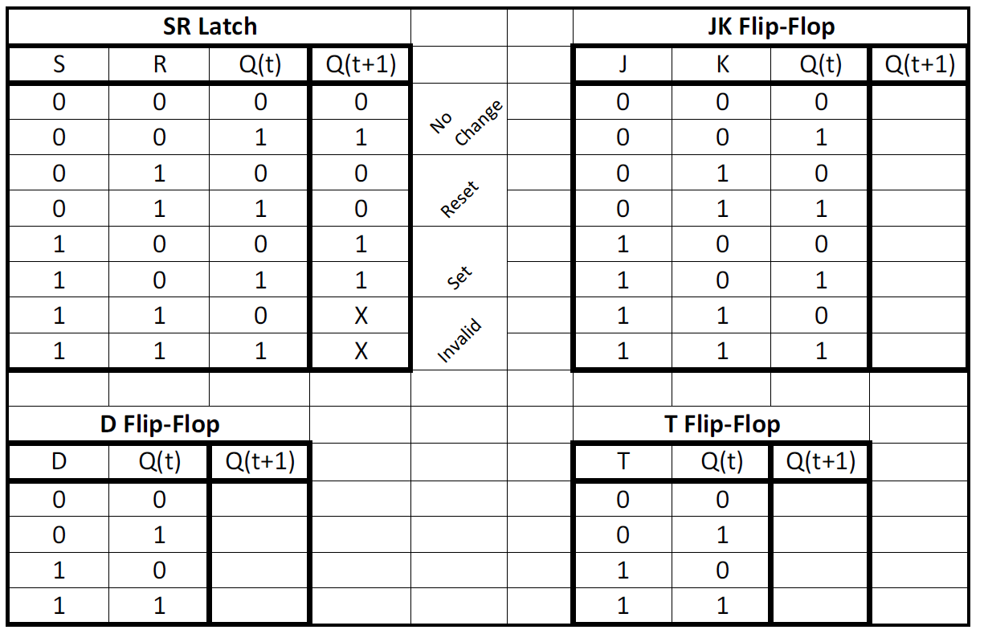
Characteristic Tables

Slide 10
Characteristic Tables

Slide 11
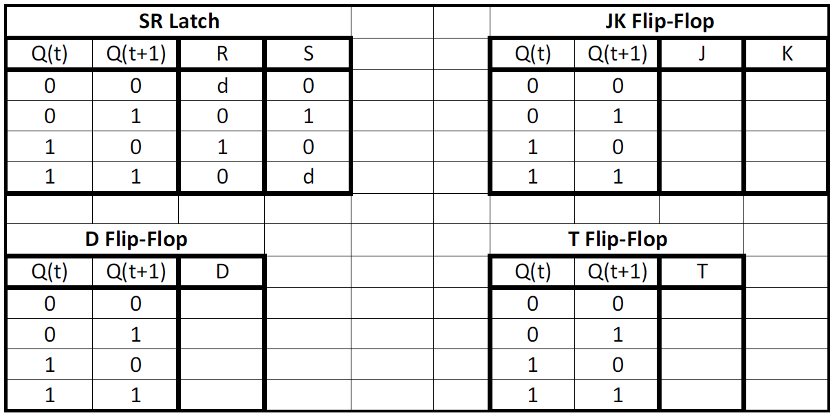
Excitation Tables

Slide 12
Excitation Tables

Slide 13
VHDL D Flip-Flop
ENTITY flipflop IS
PORT ( D, Resetn, Clock : IN STD_LOGIC ;
Q : OUT STD_LOGIC) ;
END flipflop ;
ARCHITECTURE Behavior OF flipflop IS
BEGIN
PROCESS ( ______________)
BEGIN
IF Resetn = '0' THEN
Q <= '0' ;
ELSIF Clock'EVENT AND Clock = '1' THEN
Q <= D ; -- notice there is no “Else” clause
END IF ;
END PROCESS ;
END Behavior ;

Slide 14
VHDL D Flip-Flop
ENTITY flipflop IS
PORT ( D, Resetn, Clock : IN STD_LOGIC ;
Q : OUT STD_LOGIC) ;
END flipflop ;
ARCHITECTURE Behavior OF flipflop IS
BEGIN
PROCESS ( Resetn, Clock )
BEGIN
IF Resetn = '0' THEN
Q <= '0' ;
ELSIF Clock'EVENT AND Clock = '1' THEN
Q <= D ; -- notice there is no “Else” clause
END IF ;
END PROCESS ;
END Behavior ;
Sens. List must be exactly this!
If-elsif must be exactly this!

Slide 15
VHDL n-Bit Register
LIBRARY ieee ;
USE ieee.std_logic_1164.all ;
ENTITY regn IS
GENERIC ( N : INTEGER := 16 ) ;
PORT ( D : IN STD_LOGIC_VECTOR(N-1 DOWNTO 0) ;
Resetn, Clock : IN STD_LOGIC ;
Q : OUT STD_LOGIC_VECTOR(N-1 DOWNTO 0) ) ;
END regn ;
ARCHITECTURE Behavior OF regn IS
BEGIN
PROCESS ( ____________________)
BEGIN
IF Resetn = '0' THEN
Q <= (OTHERS => '0') ;
ELSIF ____________________________ THEN
Q <= D ;
END IF ;
END PROCESS ;
END Behavior ;

Slide 16
VHDL n-Bit Register
LIBRARY ieee ;
USE ieee.std_logic_1164.all ;
ENTITY regn IS
GENERIC ( N : INTEGER := 16 ) ;
PORT ( D : IN STD_LOGIC_VECTOR(N-1 DOWNTO 0) ;
Resetn, Clock : IN STD_LOGIC ;
Q : OUT STD_LOGIC_VECTOR(N-1 DOWNTO 0) ) ;
END regn ;
ARCHITECTURE Behavior OF regn IS
BEGIN
PROCESS ( Resetn, Clock )
BEGIN
IF Resetn = '0' THEN
Q <= (OTHERS => '0') ;
ELSIF Clock'EVENT AND Clock = '1' THEN
Q <= D ;
END IF ;
END PROCESS ;
END Behavior ;

Slide 17
Flip-Flop Test Bench
Device Under Test (DUT)
Inputs
Outputs
Test Bench
Outputs
Inputs

Slide 18
Test Bench Code
ENTITY flipflop_TestBench IS
END flipflop_TestBench;
ARCHITECTURE test OF flipflop_TestBench IS
component flipflop IS port ( -- declare the component
D, Resetn, Clock : IN STD_LOGIC ;
Q : OUT STD_LOGIC) ;
end component flipflop ;
signal Dsig : std_logic; -- declare the internal signals
signal Resetnsig : std_logic;
signal Clocksig : std_logic;
signal Qsig : std_logic;
BEGIN
DUT: flipflop port map ( -- instantiate the flipflop
D => Dsig, Resetn => Resetnsig, Clock => Clocksig, Q => Qsig
);

Slide 19
Test Bench Code (cont.)
process is -- no sensitivity list => use “wait” instead
begin
Resetnsig <= '0';
Clocksig <= '0';
Dsig <= '1';
wait for 10 ns; -- reset everything
assert Qsig = '0' report "Q not reset to zero"
severity WARNING;
Resetn <= '1';
wait for 10 ns; -- reset off, but still Q=0
assert Qsig = '0' report "Q not staying at zero after reset"
severity WARNING;
Clocksig <= '1'; -- rising edge should clock in D=1
wait for 10 ns; -- let clock edge do something
assert Qsig = '1' report "Q should now be 1"
severity WARNING;

Slide 20
Test Bench Code (cont.)
Dsig <= '0';
wait for 10 ns; -- should be no change when changing D
assert Qsig = '1' report "Q not staying as 1"
severity WARNING;
Clocksig <= '0';
wait for 10 ns; -- should be no change with falling clk
assert Qsig = '1' report “Q changed on falling clock"
severity WARNING;
Clocksig <= '1'; -- rising edge
wait for 10 ns; -- D=0 should be clocked in
assert Qsig = '0' report “D=0 not clocked in"
severity WARNING;
wait; -- never go past this spot – infinite loop-like
end process;
END test;

Slide 21
Sequential Devices
Registers
Shift
Parallel In, Serial Out
Counters
Up, down, up/down, modulo-n
Ring, Johnson (also shift registers)

Slide 22
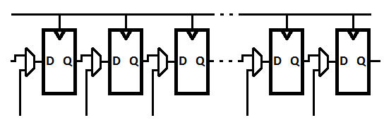
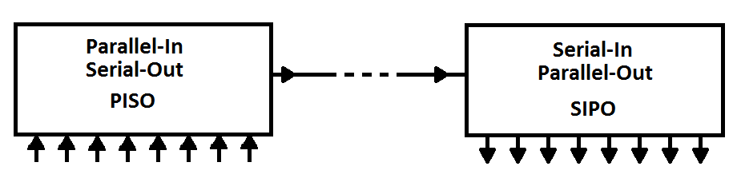
Shift Register Example

Slide 23
Asynchronous Counter
1
T
Q
T
Q
T
Q
Clock
Q
Q
Q
Q
Q
Q
0
1
2
Flip-flops are always set to toggle – must control the clock

Slide 24
Synchronous Counter
1
T
Q
T
Q
T
Q
T
Q
Q
Q
Q
Q
0
1
2
3
Clock
Q
Q
Q
Q
Always clocked – must control toggling with proper flip-flop inputs -> preferred design!

Slide 25
Modulo-n Counters
1
T
Q
T
Q
T
Q
Q
Q
Q
0
1
2
Clock
Q
Q
Q
As soon as count(Q2 Q1 Q0) = ________________then asynchronously clear flip-flops.
(5 is never really seen by the user)

Slide 26
Modulo-n Counters
1
T
Q
T
Q
T
Q
Q
Q
Q
0
1
2
Clock
Q
Q
Q
- As soon as count(Q2 Q1 Q0) = “1d1” = 5 (or 7), then asynchronously clear flip-flops. (5 is never really seen by the user)
- Also, consider the 001 to 010 transition

Slide 27
Modulo-n Counter
Asynchronous load or clear
Check for trouble with bits changing slightly out of order
Best practice is to only use asynchronous clearing through the global chip reset

Slide 28
VHDL Enabled Counter
LIBRARY ieee ;
USE ieee.std_logic_1164.all ;
USE ieee.std_logic_unsigned.all ;
ENTITY upcount IS
PORT ( Clock, Resetn, E : IN STD_LOGIC ;
Q : OUT STD_LOGIC_VECTOR (3 DOWNTO 0)) ;
END upcount ;
ARCHITECTURE Behavior OF upcount IS
SIGNAL Count : STD_LOGIC_VECTOR (3 DOWNTO 0) ;
BEGIN
PROCESS ( Clock, Resetn )
BEGIN
IF Resetn = '0' THEN Count <= "0000" ;
ELSIF (Clock'EVENT AND Clock = '1') THEN
IF E = '1' THEN Count <= Count + 1 ;
ELSE Count <= Count ;
END IF ;
END IF ;
END PROCESS ;
Q <= Count ; -- finally, assign the output Q from the signal Count
END Behavior ;

Slide 29
VHDL Enabled Counter
LIBRARY ieee ;
USE ieee.std_logic_1164.all ;
USE ieee.std_logic_unsigned.all ;
ENTITY upcount IS
PORT ( Clock, Resetn, E : IN STD_LOGIC ;
Q : OUT STD_LOGIC_VECTOR (3 DOWNTO 0)) ;
END upcount ;
ARCHITECTURE Behavior OF upcount IS
SIGNAL Count : STD_LOGIC_VECTOR (3 DOWNTO 0) ;
BEGIN
PROCESS ( Clock, Resetn )
BEGIN
IF Resetn = '0' THEN Count <= "0000" ;
ELSIF (Clock'EVENT AND Clock = '1') THEN
IF E = '1' THEN Count <= Count + 1 ;
-- ELSE Count <= Count ; -- not needed as assumed
END IF ;
END IF ;
END PROCESS ;
Q <= Count ; -- finally, assign the output Q from the signal Count
END Behavior ;

Slide 30
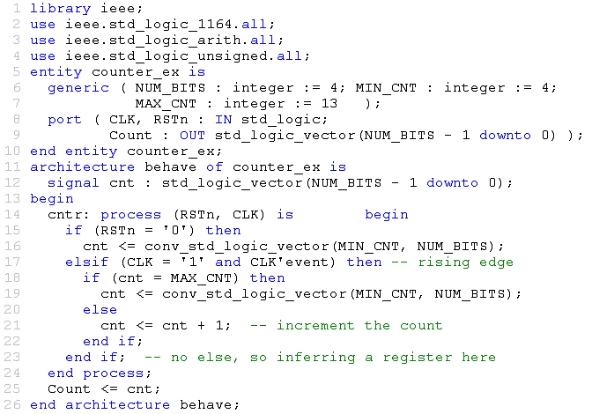
VHDL Modulo-n Counter

Slide 31
VHDL Enabled Counter
ARCHITECTURE Behavior OF counter IS
component counter_ex is
generic(NUM_BITS : integer := 4; MIN_CNT : integer := 4;
MAX_CNT : integer := 13);
port(CLK, RSTn : IN std_logic;
Count : OUT std_logic_vector((NUM_BITS – 1 downto 0));
end component counter_ex;
BEGIN
C0 : component counter_ex
generic map (NUM_BITS => 4, MIN_CNT => 2, MAX_CNT => 11)
port map (CLK => my_clock, RSTn => my_reset, Count => Count0);
C1 : component counter_ex
generic map (NUM_BITS => 6, MIN_CNT => 3, MAX_CNT => 49)
port map (CLK => my_clock, RSTn => my_reset, Count => Count1);
C2 : component counter_ex
generic map (NUM_BITS => 3, MIN_CNT => 1, MAX_CNT => 7)
port map (CLK => my_clock, RSTn => my_reset, Count => Count2);
END Behavior ;

Slide 32
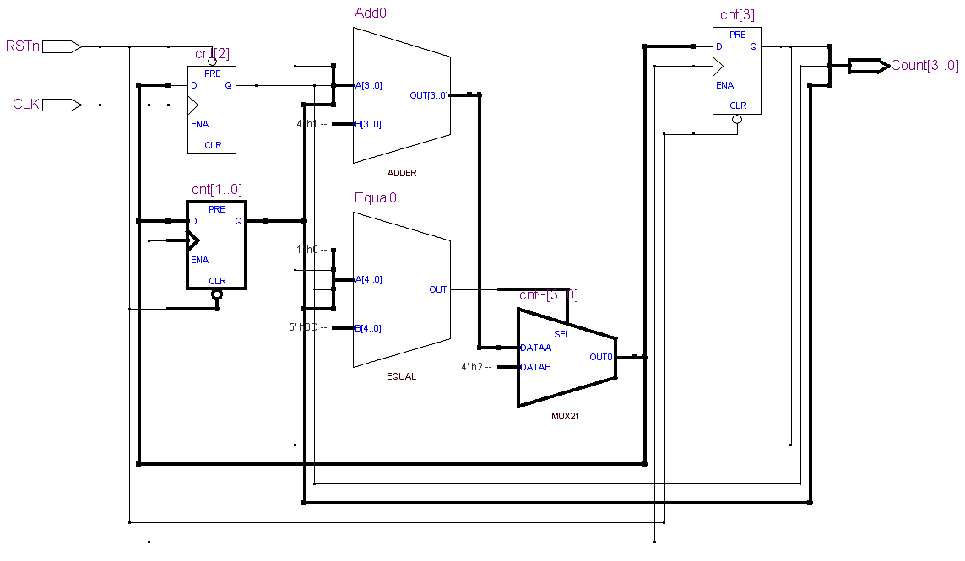
VHDL Modulo-n Counter - Quartus

